Slide 1

Bank Marketing Segmentation
Ahmed ali baig

Slide 2
WHAT IS MARKET SEGMENTATION?
In marketing, market segmentation is the process of dividing a broad consumer or business market, normally consisting of existing and potential customers, into subgroups of consumers based on some type of shared characteristics.

Slide 3
OBJECTIVE
A case requires to develop a customer segmentation to give recommendations like saving plans, loans, wealth management, etc. on target customers groups

Slide 4
THE PROBLEM STATEMENT AND BUSINESS CASE
In this project , I have search and collected data Kaggle which contains extensive data on the bank customers for the past 6 months.
Data includes transactions frequency, amount, tenure etc.
I like to leverage AI/ML to launch a targeted marketing ad campaign that is tailored to specific group of customers.
In order for this campaign to be successful, the bank has to divide its customers into at least 3 distinctive groups.
This process is known as "marketing segmentation" and it crucial for maximizing marketing campaign conversion rate.

Slide 5
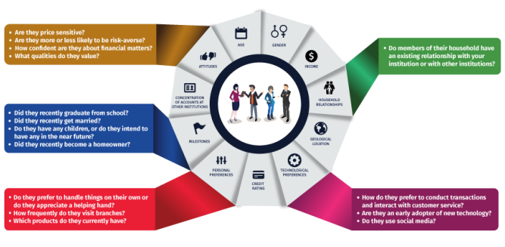
PROJECT OVERVIEW
One of the key pain points for marketers is to `know their customers` and `identify their needs.

Slide 6
DATA DESCRIPTIION
1. CUSTID: Identification of Credit Card holder
2. BALANCE: Balance amount left in customer's account to make purchases
3. BALANCE_FREQUENCY: How frequently the Balance is updated, score between 0 and 1 (1 = frequently updated, 0 = not frequently updated)
4. PURCHASES: Amount of purchases made from account
5. ONEOFFPURCHASES: Maximum purchase amount done in one-go
6. INSTALLMENTS_PURCHASES: Amount of purchase done in installment
7. CASH_ADVANCE: Cash in advance given by the user

Slide 7
DATA DESCRIPTIION
8. PURCHASES_FREQUENCY: How frequently the Purchases are being made, score between 0 and 1 (1 = frequently purchased, 0 = not frequently purchased)
9. ONEOFF_PURCHASES_FREQUENCY: How frequently Purchases are happening in one-go (1 = frequently purchased, 0 = not frequently purchased)
10. PURCHASES_INSTALLMENTS_FREQUENCY: How frequently purchases in installments are being done (1 = frequently done, 0 = not frequently done)
11. CASH_ADVANCE_FREQUENCY: How frequently the cash in advance being paid
12. CASH_ADVANCE_TRX: Number of Transactions made with "Cash in Advance“

Slide 8
DATA DESCRIPTIION
13. PURCHASES_TRX: Number of purchase transactions made
14. CREDIT_LIMIT: Limit of Credit Card for user
15. PAYMENTS: Amount of Payment done by user
16. MINIMUM_PAYMENTS: Minimum amount of payments made by user
17. PRC_FULL_PAYMENT: Percent of full payment paid by user
18. TENURE: Tenure of credit card service for user

Slide 9
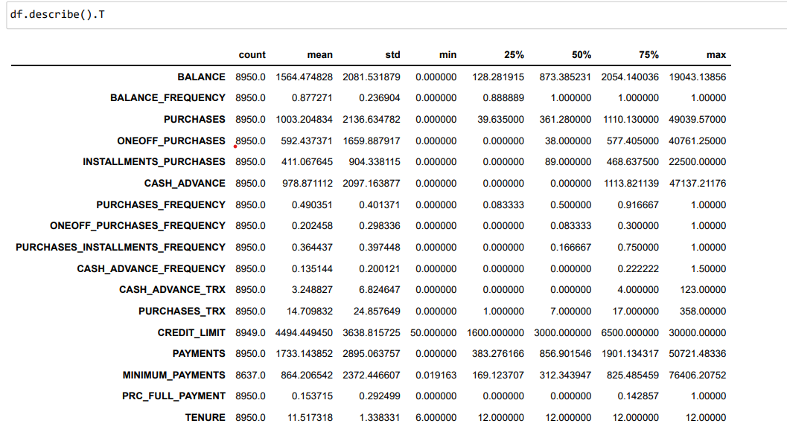
PERFORMING DATA ANALYSIS
A) Describing the data
Insights 1. Mean balance is $1564 2. Balance frequency is frequently updated on average ~0.9 3. Purchases average is $1000 4. one off purchase average is ~$600 5. Average purchases frequency is around 0.5 6. average ONEOFF_PURCHASES_FREQUENCY, PURCHASES_INSTALLMENTS_FREQUENCY, and CASH_ADVANCE_FREQUENCY are generally low 7. Average credit limit ~ 4500 8. Percent of full payment is 15% 9. Average tenure is 11 years
-So, to start with our problem, we will clean the dataset by checking for null values, handling outliers, checking for data consistency.

Slide 10
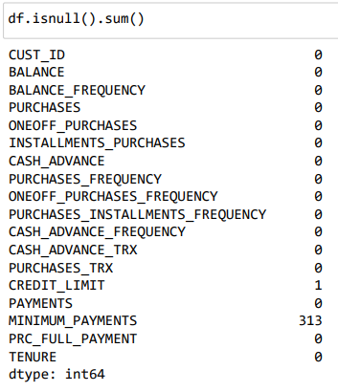
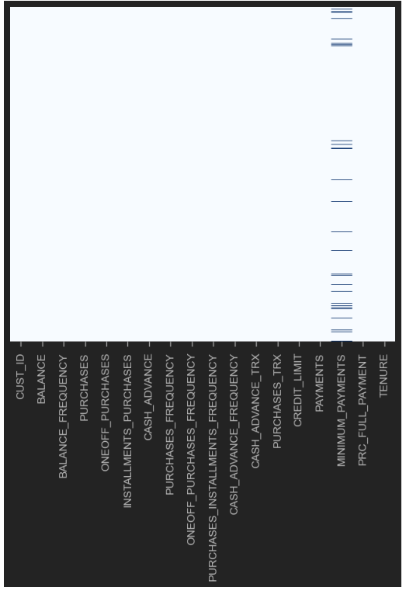
PERFORMING DATA ANALYSIS
B) Checking for missing values –
Let's see if we have any missing data
Replacing missing value with mean

Slide 11
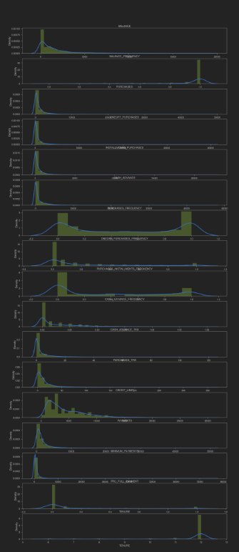
DATA VISUALIZATION
Insights
1. Mean of balance is 1500 dollors
2. 'Balance_Frequency' for most customers is updated frequently ~1
3. For 'PURCHASES_FREQUENCY', there are two distinct group of customers
4. For 'ONEOFF_PURCHASES_FREQUENCY' and 'PURCHASES_INSTALLMENT_FREQUENCY' most users
don't do one off puchases or installment purchases frequently
5. Very small number of customers pay their balance in full 'PRC_FULL_PAYMENT'~0 6. Credit limit
average is around $4500 7. Most customers are ~11 or ~12 years tenure

Slide 12
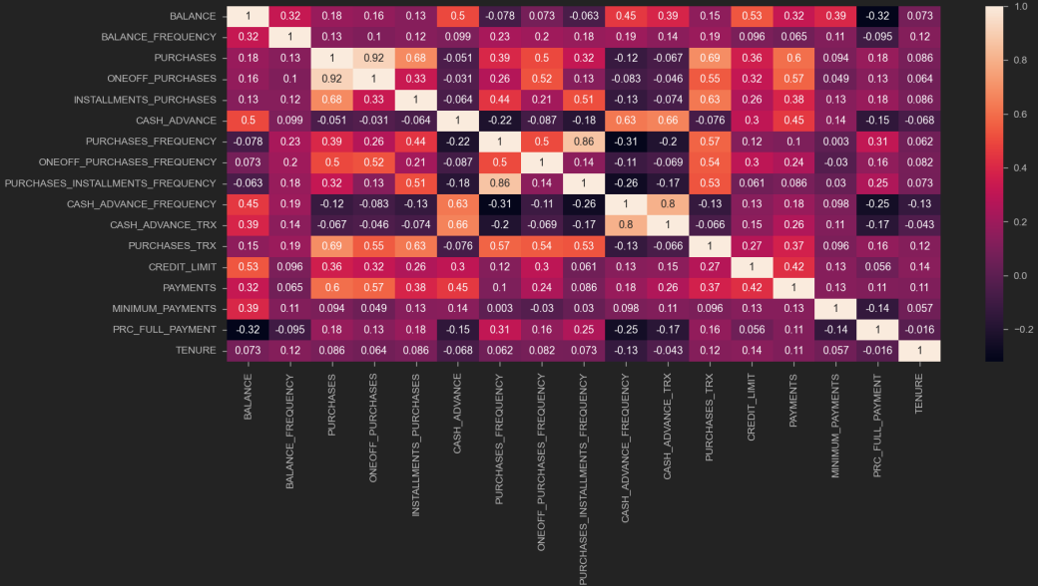
DATA VISUALIZATION
Insights
1. 'PURCHASES' have high correlation between
one-off purchases, 'installment purchases,
purchase transactions and payments.
2. Strong Positive Correlation between
'PURCHASES_FREQUENCY' and
'PURCHASES_INSTALLMENT_FREQUENCY'

Slide 13
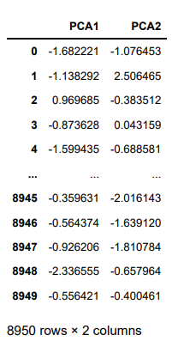
PRINCIPAL COMPONENT ANALYSIS (PCA)
PCA is an unsupervised machine learning algorithm.
PCA performs dimensionality reductions while attempting at keeping the original.
PCA works by trying to find a new set of features called components.
Components are composites of the uncorrelated given input features.

Slide 14
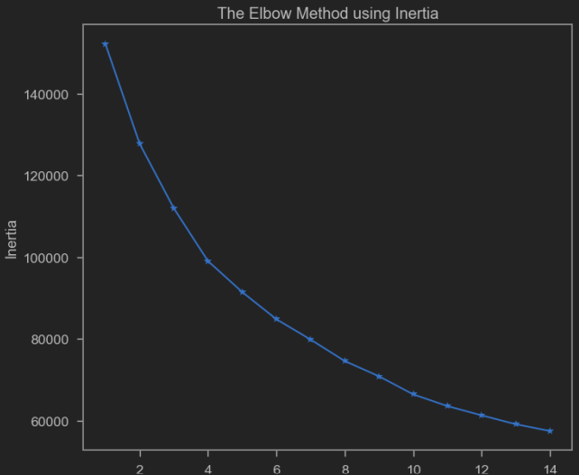
Model Evaluation
K-Mean Clustering
`K-means` is an unsupervised learning algorithm (clustering). K-means works by grouping some data points together (clustering) in an unsupervised. The algorithm groups observations with similar attribute values together by measuring the Euclidian distance between points.
-Elbow method is customer check how many clusters are best for my
Model. Here you can clearly see its 4.
-The score is impressive which means our cluster are neither
overlapping nor tight clusters.

Slide 15
the following plot should give us a better understanding on our clusters:

Slide 16
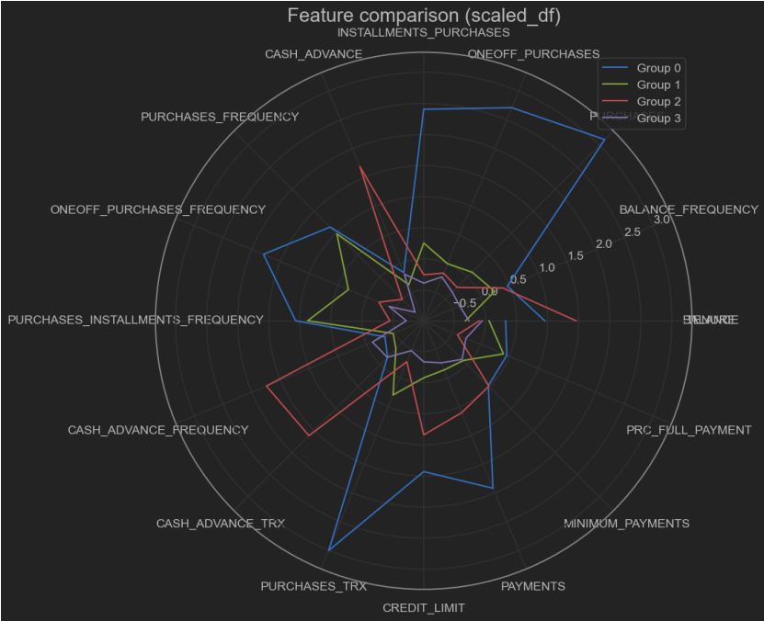
Standard, Imputed Data vs Labels!
The following plot should give us a better understanding on our clusters:

Slide 17
Standard, Imputed Data vs Labels!
Wow! now we are talking. I know it's hard to read, but I just want you to notice these points:
Group 0 contains customers who have a good income (second highest BALANCE ) and are enjoying it! they purchase a lot (highest PURCHASESFREQUENCY ), both in installments and in one-go. let's call them Bourgeoisie!
Group 1 contains customers who don't make a lot of money (look at their BALANCE , it is the lowest of all) but this doen't keep them away from purchasing stuff! in terms of PURCHASES , they are the second class. how do they do this? take a closer look: they don't buy stuff in one go (they have lowest ammount of ONEOFF_PURCHASES and ONEOFF PURCHASES FREQUENCY ) their key to success is instalments! It's easy: if you don't make enough money to buy stuff in one go, just pay over a period of time. (They have highest values of INSTALLMENTSPURCHASES and PURCHASESINSTALLMENTSFREQUENCY I refer to these people as Dreamers because although they don't make much money, lack of money doesn't prevent them from reaching for their dreams!

Slide 18
Standard, Imputed Data vs Labels!
Group 2 is mysterious. look at them! they have highest BALANCE , but lowest PURCHASE of all! it seems they only use their fortunes when they want pay in advance (highest CASHADVANCE , CASHADVANCEFREQUENCY and CASHADVANCETRX ). A cash advance is a service provided by most credit card and charge card issuers. The service allows cardholders to withdraw cash, either through an ATM or over the counter at a bank or other financial agency, up to a certain limit. For a credit card, this will be the credit limit (or some percentage of it). so, these guys don't use their credit cards to buy stuff, instead, they get chash from ATMs to do so. why? it is beause they want to buy something illegal? Let's just call them The Mafia for now.
Group 3 shows customers who are not very rich, and don't take risks. their BALANCE (amount left in their account to make purchases) is below average, and they don't purchase much. (their PURCHASES is below average as well, and their PURCHASE FREQUENCY is very low.) I call these people Economicals. to them, every penny is important.

Slide 19
Let do some more EDA
Evaluating our hypothesis now,
I want to plot our data using only BALANCE and PURCHASES. this is my hypothesis:
If BALANCE is high and PURCHASES is high ➡ Class 0 (Bourgeoisie 🛍)
If BALANCE is low and PURCHASES is high ➡ Class 1 (Dreamers ✨)
If BALANCE is high and PURCHASES is low ➡ Class 2 (The Mafia 🕶)
If BALANCE is low and PURCHASES is low Class 3 (Economicals 💲)

Slide 20
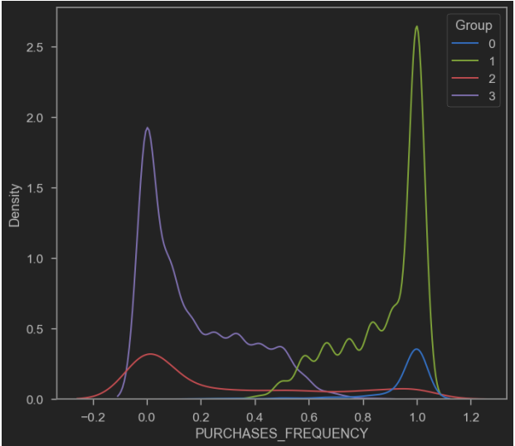
Looking at this plot, it is obvious that the mafia and economicals are purchasing less often than dreamers and Bourgeoisie

Slide 21
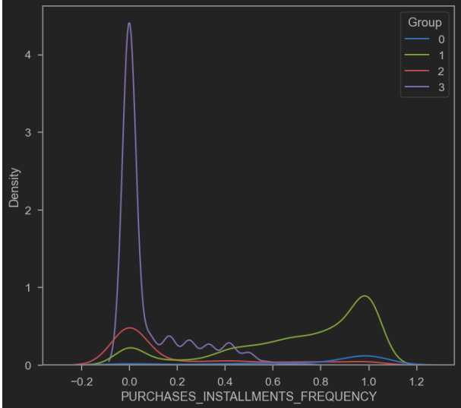
This plot shows how the dreamers are trying to buy whatever they persue, by buying first and paying later.

Slide 22
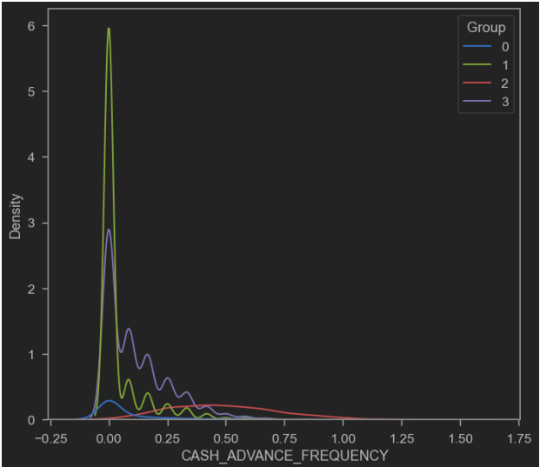
Here, this plot shows that the infamous mafia are getting cash from ATMs more often than other groups.

Slide 23
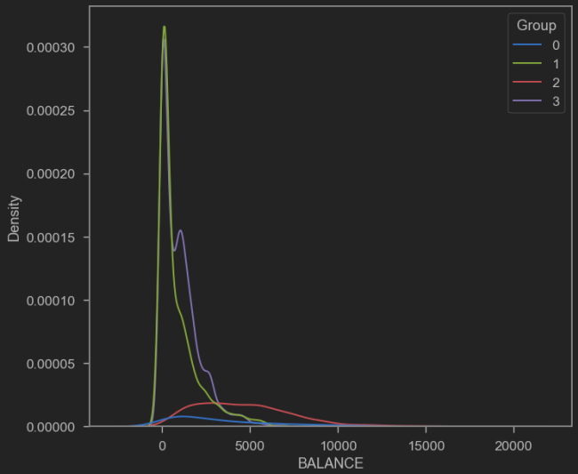
The mafia and the Bourgeoisie has highest balance then others

Slide 24
It looks like my hypothesis was quite right.
In this plot, it is clear that:
People of Class 0 have high balance and purchase a lot
People of Class 1 spend a lot while they have low balance.
People of Class 2 have a low balance and spend less than others
People of Class 3 don't purchase much, although they have lots of money we can further investigate this hypothesis using some plots:

Slide 25
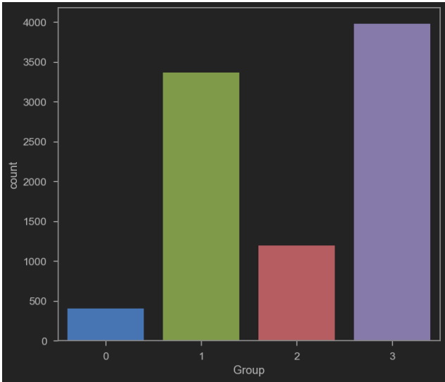
This shows how my data is distributed in the clusters.

Slide 26
Thank you!

